Slide 1
Supply Chain Management
project by Arnav saini

Slide 2
Problem Statement :
An FMCG company entered into the instant noodles business two years back. Their higher management has noticed that there is a miss match in the demand and supply. Where the demand is high, supply is pretty low and where the demand is low, supply is pretty high. In both ways, it is an inventory cost loss to the company; hence, the higher management wants to optimize the supply quantity in every warehouse in the entire country.

Slide 3
Data Summary
We will be using Multiple features to predict the Target variable
i.e. Product Weight in tons.
We have some of the important feature as follows:
Location_type : Location of warehouse-like in city or village.
WH_capacity_size : Storage capacity size of the warehouse.
Zone : zone and regional zone of the warehouse.
Transport_issue : Any transport issue like accident or goods stolen reported .
storage_issue_reported : Warehouse reported storage issue in last 3 months. Like rat, fungus because of moisture etc.
Wh_breakdown : Number of time warehouse face a breakdown in last 3 months. Like strike from worker, flood, or electrical failure

Slide 4
Competitor_in_mkt : Number of instant noodles competitors in the market.
retail_shop_num : Number of the retail shop that sell the product under the warehouse area.
distributor_num : The number of distributer works in between warehouse and retail shops.
flood_impacted : Warehouse is in the Flood impacted area indicator.
Flood_proof : Warehouse is a flood-proof indicator. Like storage is at some specific height.
dist_from_hub : Distance between warehouse to the production hub in Kms .

Slide 5
Pre-processing Steps Used
We have 25000 rows and 24 columns .
We have 24 features out of which 8 are of Object Datatype while
rest are integer and float .
There are some Null values or missing values in the Dataset .
I have Imputed Median and Mode respectively .
Dropping Warehouse established Year as most of the values are missing and it is not relevant to Target Variable.
Moreover , we can’t impute any random values as it will cause bias
and we don’t know the year it was established in.
Also dropped Id of manager and warehouse as it is similar to serial number.
Plotting Heatmap to check Null values , Figure below:

Slide 6
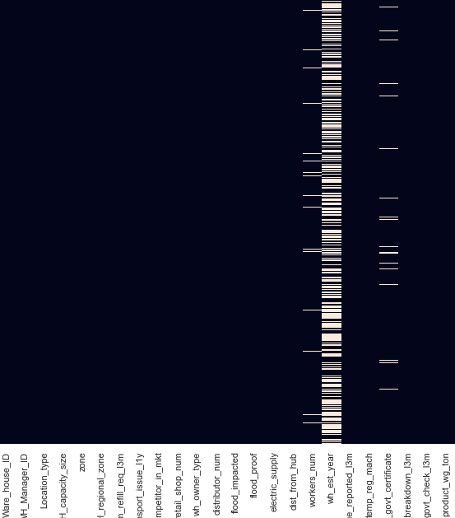

Slide 7
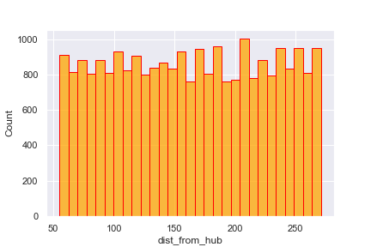
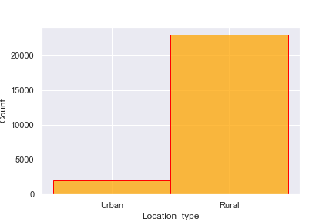
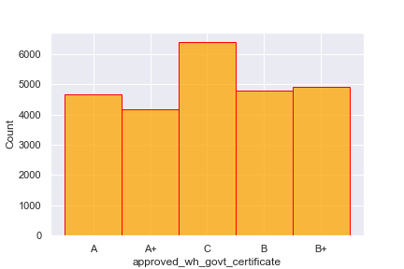
Visualization

Slide 8
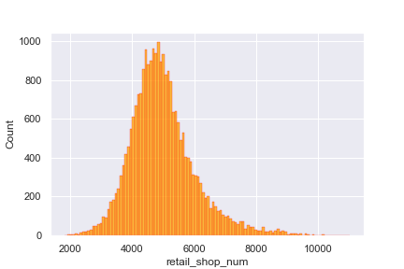
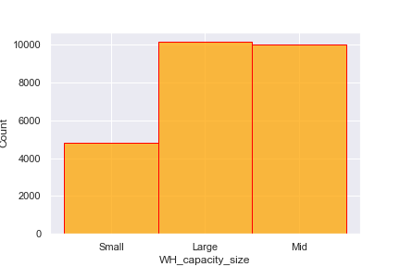
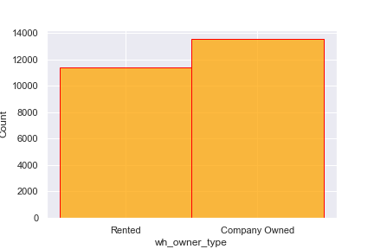
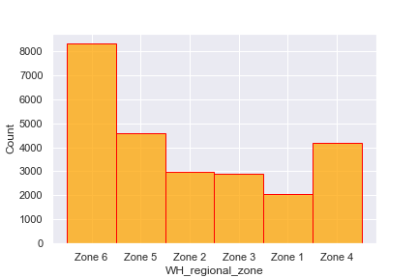

Slide 9
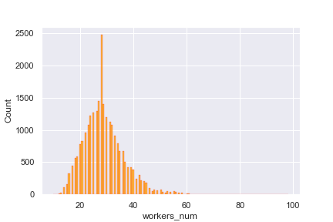
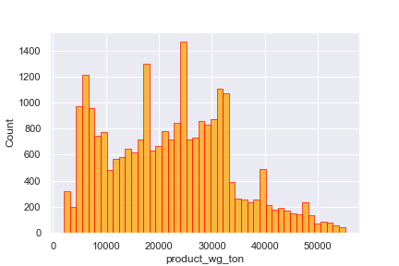
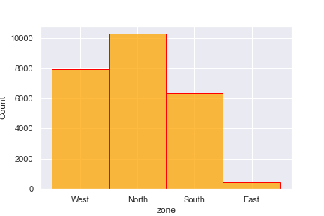

Slide 10
There are no duplicate values in the dataset .
Converted categorical values to numerical values using Label Encoder .
Used Box plot to identify outliers and only two columns had outliers i.e workers number and retail shop number.
As it is True Outlier I will consider it .
Using Correlation Matrix , we can conclude how variables are related to each other , No two features have correlation coefficeint above 0.7 in correlation Matrix. Thus , no Multi-Collinearity Problem .
Figure below:

Slide 11
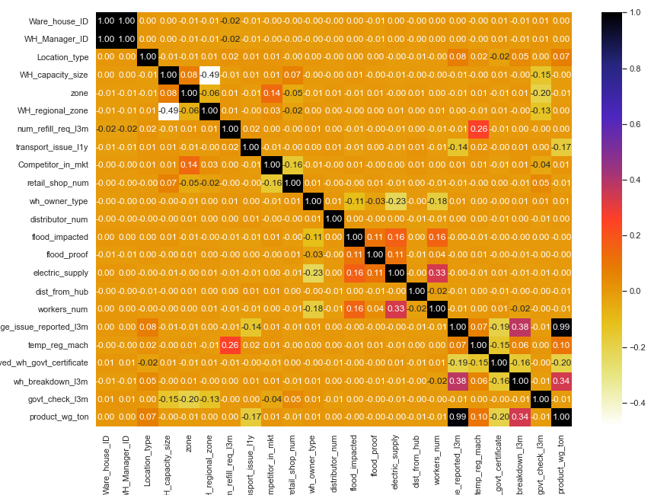

Slide 12
Model Building and Evaluation
Before Building the model I have scaled both x_train and x_test using Standard Scalar and to avoid DATA LEAKAGE I have scaled them separately.
LinearRegression R2 score
For Training : 0.977 For Testing : 0.976
Root mean Squared error : 1786.96
DecisionTreeRegressor R2 score
For Training : 1.0 For Testing : 0.988
Root mean Squared error : 1234.13
ExtraTreesRegressor R2 score
For Training : 1.0 For Testing : 0.993
Root mean Squared error : 954.87

Slide 13
RandomForestRegressor R2 score
For Training : 0.999 For Testing : 0.993
Root mean Squared error : 931.93
AdaBoostRegressor R2 score
For Training : 0.978 For Testing : 0.979
Root mean Squared error : 1690.40
GradientBoostingRegressor R2 score :
For Training : 0.994 For Testing : 0.993
Root mean Squared error : 918.53

Slide 14
Hyper-Parameter Tuning
Comparing Two best models:
For RandomForestRegressor
R2 score for training: 0.998 R2 score for testing : 0.993
Root mean Squared error : 932.00
Root mean Squared error hasn't improved much after Hyper parameter tuning
For Gradient Boosting Regressor
R2 score for training: 0.995 R2 score for testing : 0.994
Root mean Squared error : 882.47
RMSE further decreased form 918 to 882.
# Thus, selecting GradientBoostingRegressor as the Final Model .

Slide 15
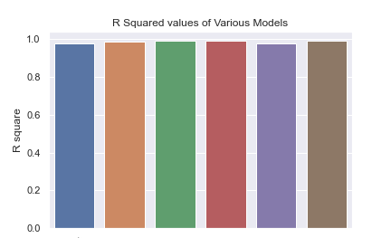
We are getting similar R2 score for all the models but RMSE helps in model selection.

Slide 16
Difficulty faced :
There were 8 categorical variables which needs to be converted to numerical value and
I have used Label Encoder to do the same.
There were some missing values which required imputing.
There were some redundant columns which had to be dropped .
Treating Outliers.
Had to use Hyper parameter tuning to get optimal results.
# CONCLUSION :
Was able to build a model that predicts with an R2 score of over 99 % in both Training and Testing with just 0.1 variance. Moreover RMSE was as low as 882.
# Model Selected : GradientBoostingRegressor .

